Slide 1

UNIVERSITY INSTITUTE OF ENGINEERING
COMPUTER SCIENCE ENGINEERING
Master of Engineering
ADVANCED DATA STRUCTURES
&
ALGORITHMS
(23CSH-622)
INTRODUCTION
DISCOVER . LEARN . EMPOWER

Slide 2

ADVANCED DATA STRUCTURES
&
ALGORITHMS
(23CSH-622)
By : Dr. Ranjit Singh (E10947)
www. cuchd.in Campus : Gharaun, Mohali

Slide 3
TOPICS TO BE COVERED
Introduction to Stacks
Stack Insertion and deletion
Introduction to Queues
Queues Insertion and deletion

Slide 4
LECTURE OBJECTIVES
Course objective is to learn about stack data structures with queues and their real time applications.
After learning this course students should be able to apply them in various domains.

Slide 5
OUTCOMES
Students will learn about stacks , Queues and their applications
Uses of Stacks
Advantages of stacks and queues
Students will be able to differentiate between stacks and Queues.

Slide 6
DEFINITION OF STACK
A stack is a container of objects that are inserted and removed according to the last-in first-out (LIFO) principle. In the pushdown stacks only two operations are allowed: push the item into the stack, and pop the item out of the stack. A stack is a limited access data structure - elements can be added and removed from the stack only at the top. push adds an item to the top of the stack, pop removes the item from the top

Slide 7
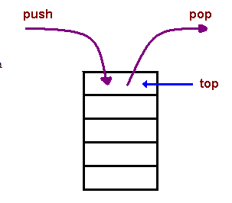
REPRESENTATIONS OF STACK
[1]

Slide 8
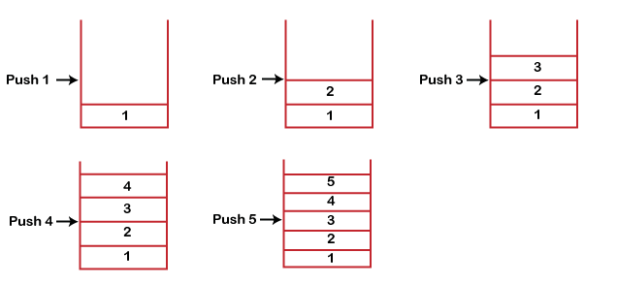
Working of stack:

Slide 9
APPLICATION OF STACK
Expression conversion
Expression Parsing: Evaluation of arithmetic and logic expression.
Function call: When we invoke function A, which contains a call to function B, then its processing will not be completed until function B has completed its execution and returned. Similarly for function B and C. So we observe that function A will only be completed after function B is completed and function B will only be completed after function C is completed. Therefore, function A is first to be started and last to be completed. To conclude, the above function activity matches the last in first out behavior and can easily be handled using Stack.

Slide 10
PUSH OPERATION
The steps involved in the PUSH operation is given below:
Before inserting an element in a stack, we check whether the stack is full.
If we try to insert the element in a stack, and the stack is full, then the overflow condition occurs.
When we initialize a stack, we set the value of top as -1 to check that the stack is empty.
When the new element is pushed in a stack, first, the value of the top gets incremented, i.e., top=top+1, and the element will be placed at the new position of the top.
The elements will be inserted until we reach the max size of the stack.

Slide 11
POP OPERATION
The steps involved in the POP operation is given below:
Before deleting the element from the stack, we check whether the stack is empty.
If we try to delete the element from the empty stack, then the underflow condition occurs.
If the stack is not empty, we first access the element which is pointed by the top
Once the pop operation is performed, the top is decremented by 1, i.e., top=top-1.
[1]

Slide 12
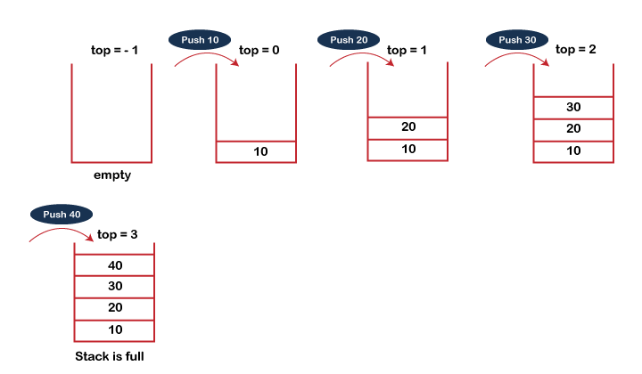
Insertion(PUSH)

Slide 13
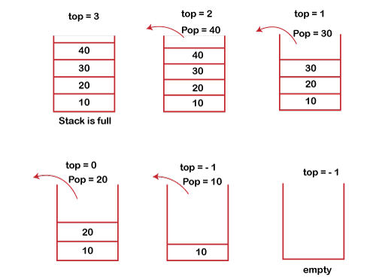
DELETION(POP)

Slide 14
APPLICATIONS
The simplest application of a stack is to reverse a word. You push a given word to stack - letter by letter - and then pop letters from the stack.
Another application is an "undo" mechanism in text editors; this operation is accomplished by keeping all text changes in a stack.
Backtracking.

Slide 15
Linked List Implementation of Stack
In linked list implementation of stack, the nodes are maintained non-contiguously in the memory. Each node contains a pointer to its immediate successor node in the stack. Stack is said to be overflown if the space left in the memory is not enough to create a node.
The top most node in the stack always contains null in its address field.

Slide 16
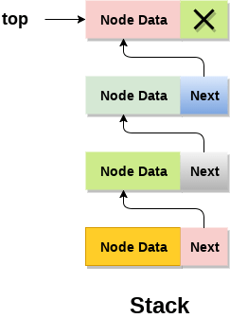

Slide 17
QUEUES
A Queue is a linear list of elements in which deletions can take place only at one end, called the front, and insertions can take place only at the other end, called the rear. The terms “front” and “rear” are used in describing a linear list only when it implemented as a queue.
Queues are also called first-in first-out (FIFO) lists, since the first element in a queue will be the first element out of the queue. In other words, the order in which elements enter a queue is the order in which they leave. This contrasts with stacks, which are Last-in First-out (LIFO) lists.

Slide 18
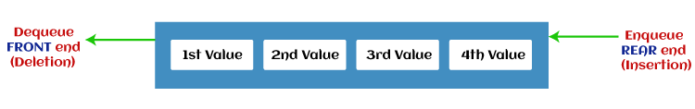
REPRESENTATION
[4]

Slide 19
APPLICATION OF QUEUES
Operating systems often maintain a queue of processes that are ready to execute or that are waiting for a particular event to occur.
FCFS Scheduling
Priority Scheduling

Slide 20
Types of queue:
Simple Queue or Linear Queue: In Linear Queue, an insertion takes place from one end while the deletion occurs from another end. The end at which the insertion takes place is known as the rear end, and the end at which the deletion takes place is known as front end. It strictly follows the FIFO rule.
Circular Queue: In Circular Queue, all the nodes are represented as circular. It is similar to the linear Queue except that the last element of the queue is connected to the first element. It is also known as Ring Buffer, as all the ends are connected to another end.
Priority Queue: It is a special type of queue in which the elements are arranged based on the priority. It is a special type of queue data structure in which every element has a priority associated with it. Insertion in priority queue takes place based on the arrival, while deletion in the priority queue occurs based on the priority. (CPU SCHEDULING)

Slide 21
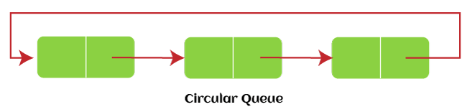
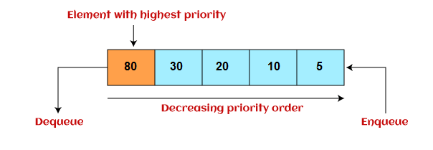

Slide 22
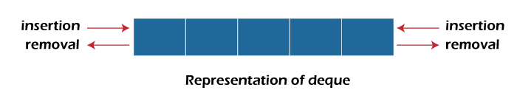
Double ended Queue
The deque stands for Double Ended Queue. Deque is a linear data structure where the insertion and deletion operations are performed from both ends. We can say that deque is a generalized version of the queue.
Though the insertion and deletion in a deque can be performed on both ends, it does not follow the FIFO rule.

Slide 23
Enqueue Operation
Below are the steps to enqueue (insert) data into a queue
Check whether the queue is full or not.
If the queue is full – print the overflow error and exit the program.
If the queue is not full – increment the rear pointer to point to the next empty space.
Else add the element in the position pointed by Rear.
Return success.

Slide 24
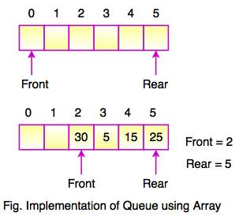
Enqueue

Slide 25
Dequeue Operation
Dequeue Operation
Below are the steps to perform dequeue operation
Check whether the queue is full or not.
If the queue is empty – print the underflow error and exit the program.
If the queue is not empty – access the data where the front is pointing.
Else increment the front pointer to point to the next available data element.
Return success.

Slide 26
REFERENCES
https://www.cs.cmu.edu/~adamchik/15-121/lectures/Stacks%20and%20Queues/Stacks%20and%20Queues.html
Data Structures with C/ schaum outline series/ volume 2
https://www.geeksforgeeks.org/stack-data-structure-introduction-program/
https://www.geeksforgeeks.org/queue-set-1introduction-and-array-implementation/
http://www.yashcode.com/2017/11/prefix-to-postfix-conversion-using-stack.html

Slide 27
Books Recommended
Lipschutz, Seymour, “Data Structures”, Schaum's Outline Series, Tata McGraw Hill.
Gilberg/Forouzan,” Data Structure with C ,Cengage Learning.
Augenstein,Moshe J , Tanenbaum, Aaron M, “Data Structures using C and C++”, Prentice Hall of India.
Goodrich, Michael T., Tamassia, Roberto, and Mount, David M., “Data Structures and Algorithms in C++”, Wiley Student Edition.
Aho, Alfred V., Ullman, Jeffrey D., Hopcroft ,John E. “Data Structures and Algorithms”, Addison Wesley

Slide 28
Queries??

